Slide 1
Point Cloud and Aerial Image Misalignment
Presented by:
Neil Getty

Slide 2
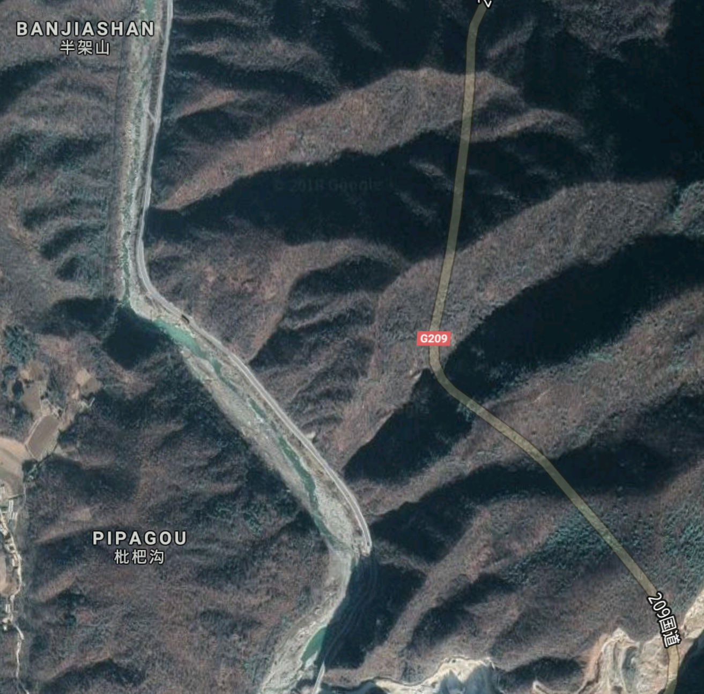
Introduction
Registering/aligning images of separate modalities is a hard but important problem
Richer, more accurate maps

Slide 3
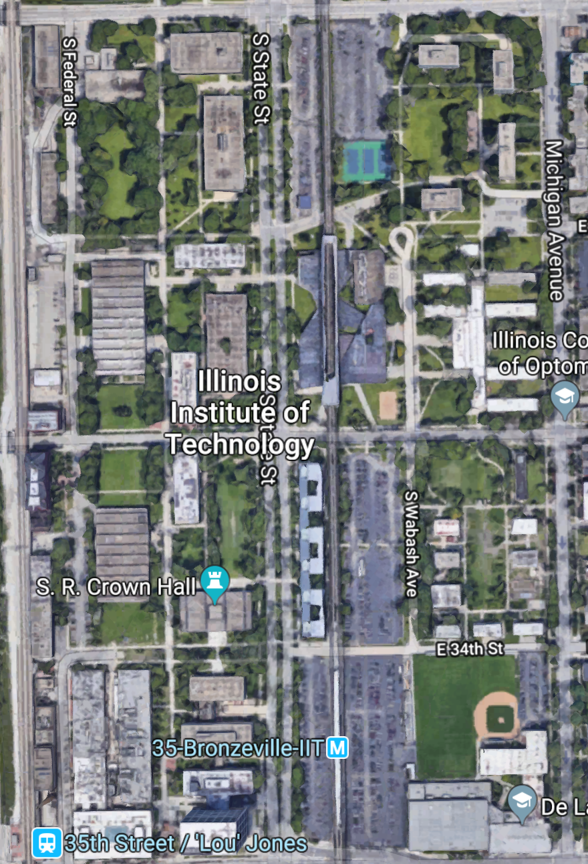
Perfect Alignment
Necessary for humans?
What about AI?
Is perfection attainable?

Slide 4
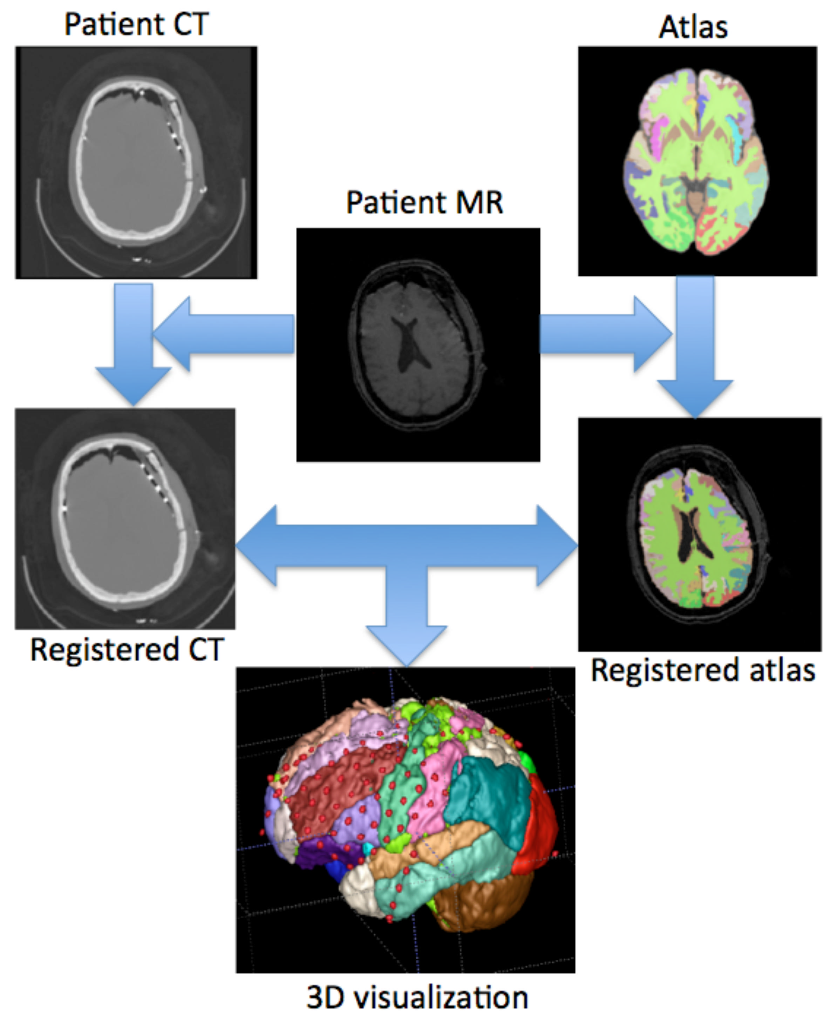
Registration problem not unique to mapping...

Slide 5
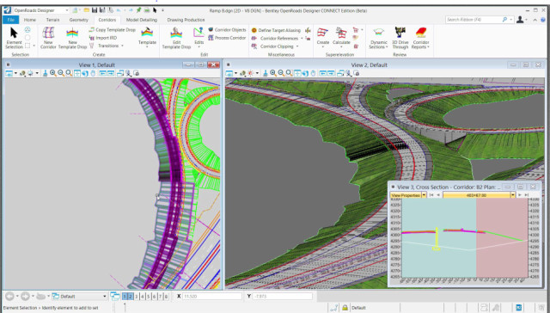
Methodologies - Manual
Use mapping software to manually edit
OpenRoads Designer:
https://www.bentley.com/en/products/product-line/civil-design-software/openroads-designer

Slide 6
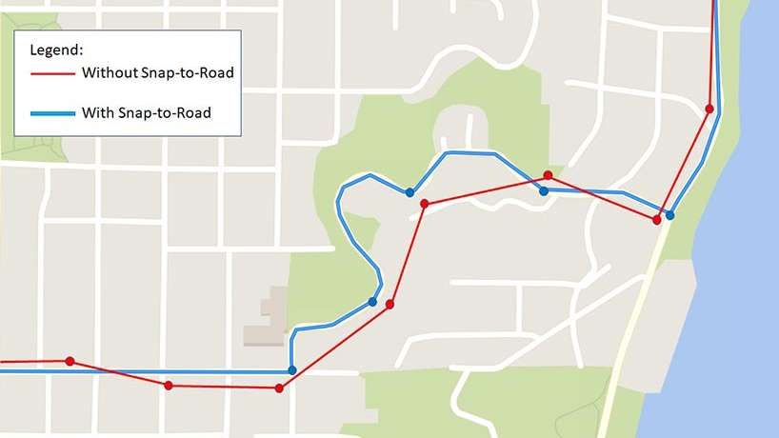
Methodologies - Automated
Bing API
Snap-to-road
https://www.microsoft.com/en-us/maps/snap-to-road

Slide 7
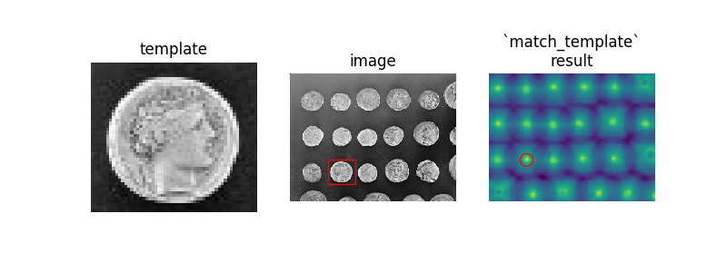
Methodologies - Automated
Normalized cross correlation
http://scikit-image.org/docs/dev/auto_examples/features_detection/plot_template.html

Slide 8
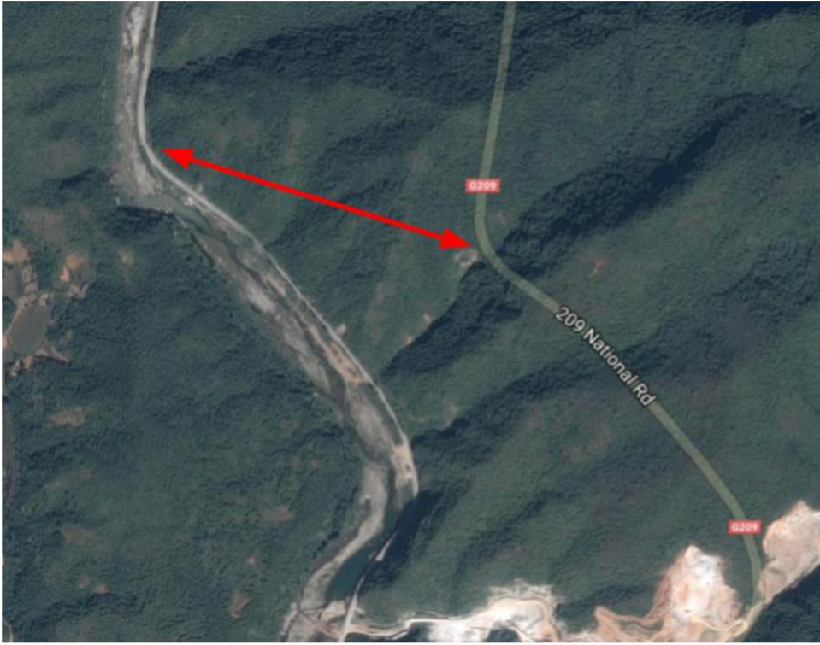
Can this be applied here?

Slide 9
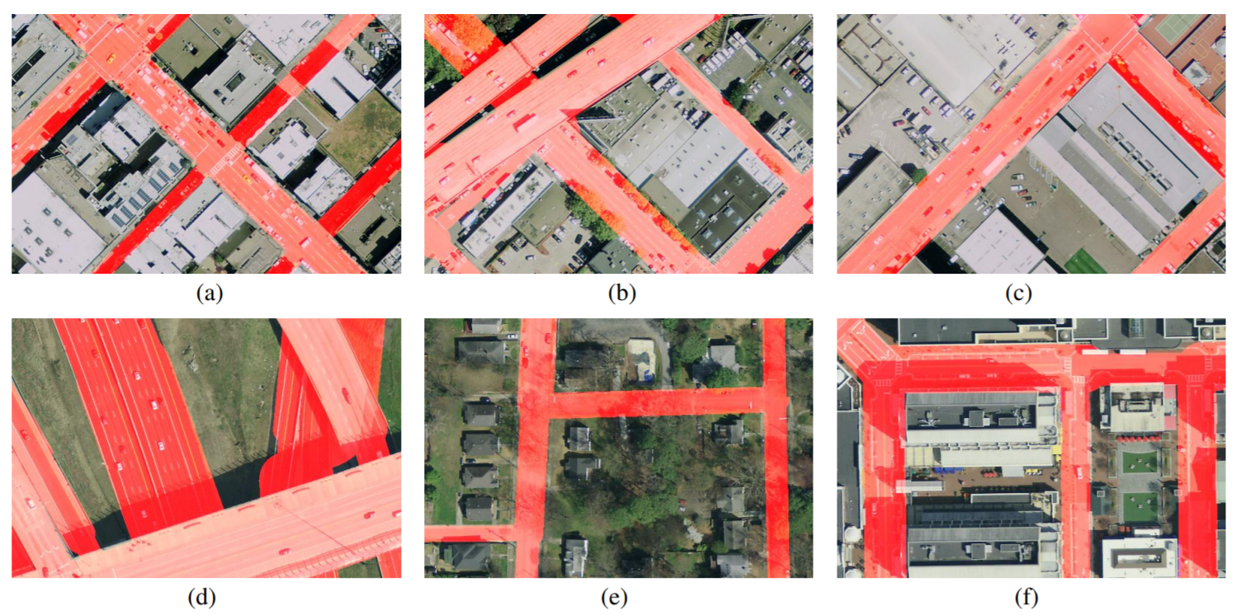
Start with segmentation
Yuan et.al. Road Segmentation in Aerial Images by Exploiting Road Vector Data

Slide 10
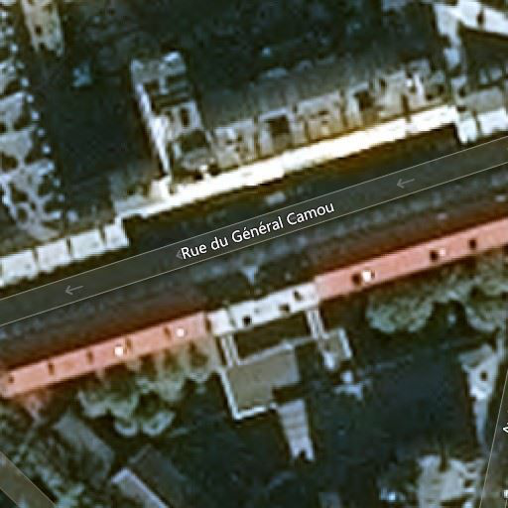
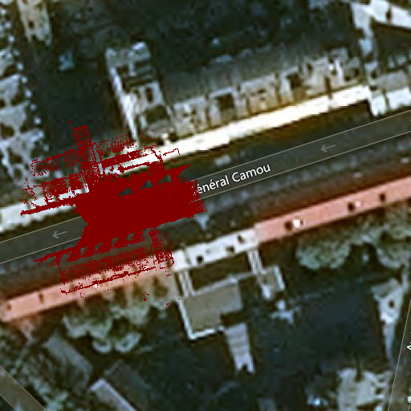
Example projection

Slide 11
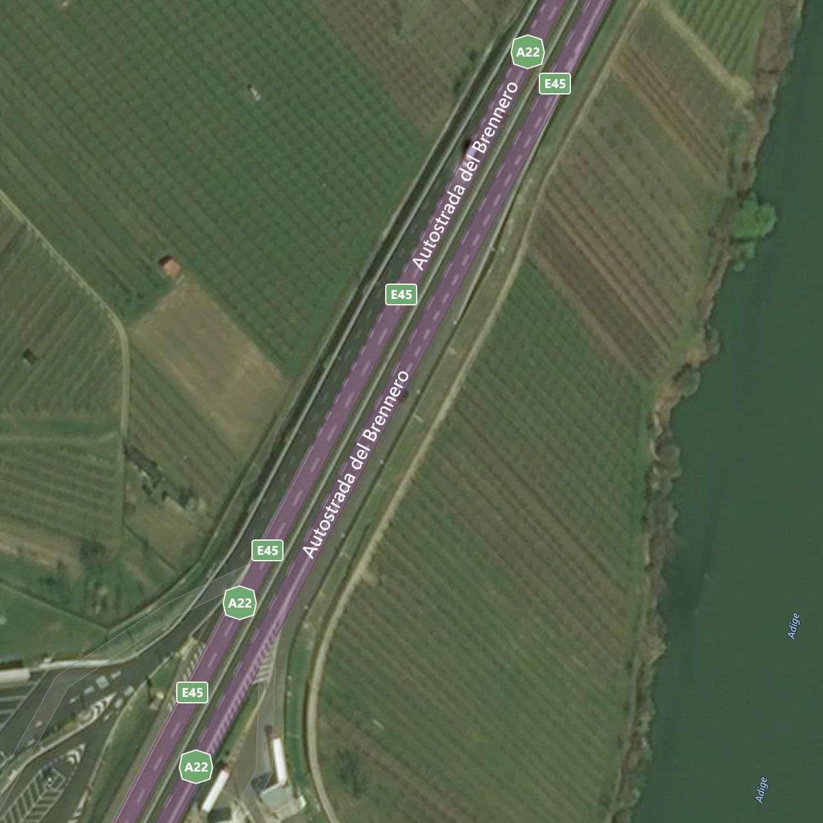
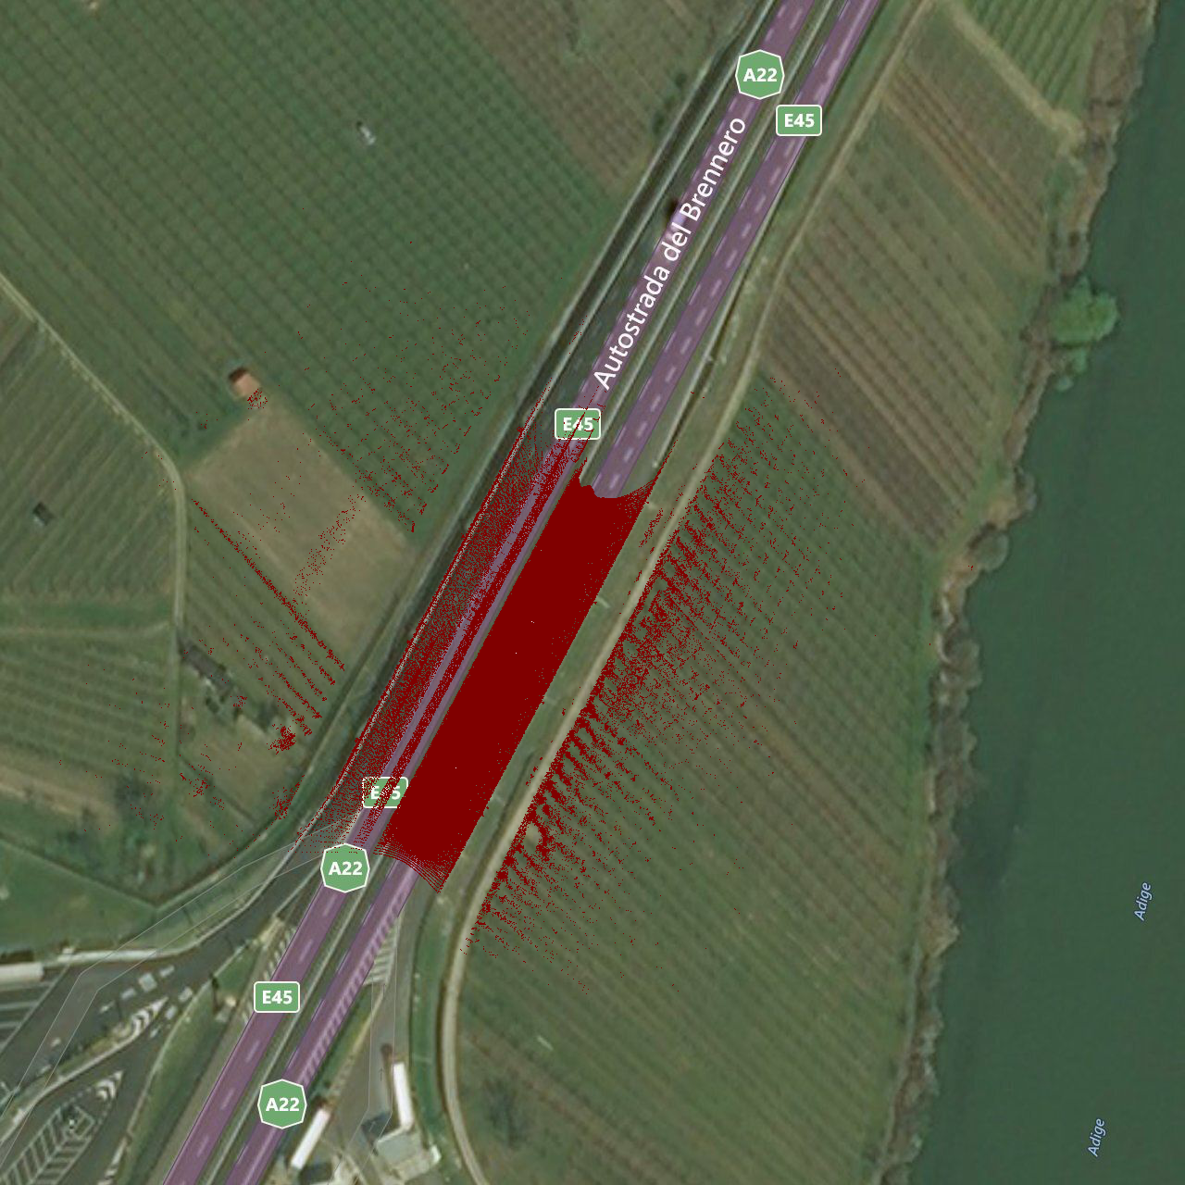
Example Projection

Slide 12
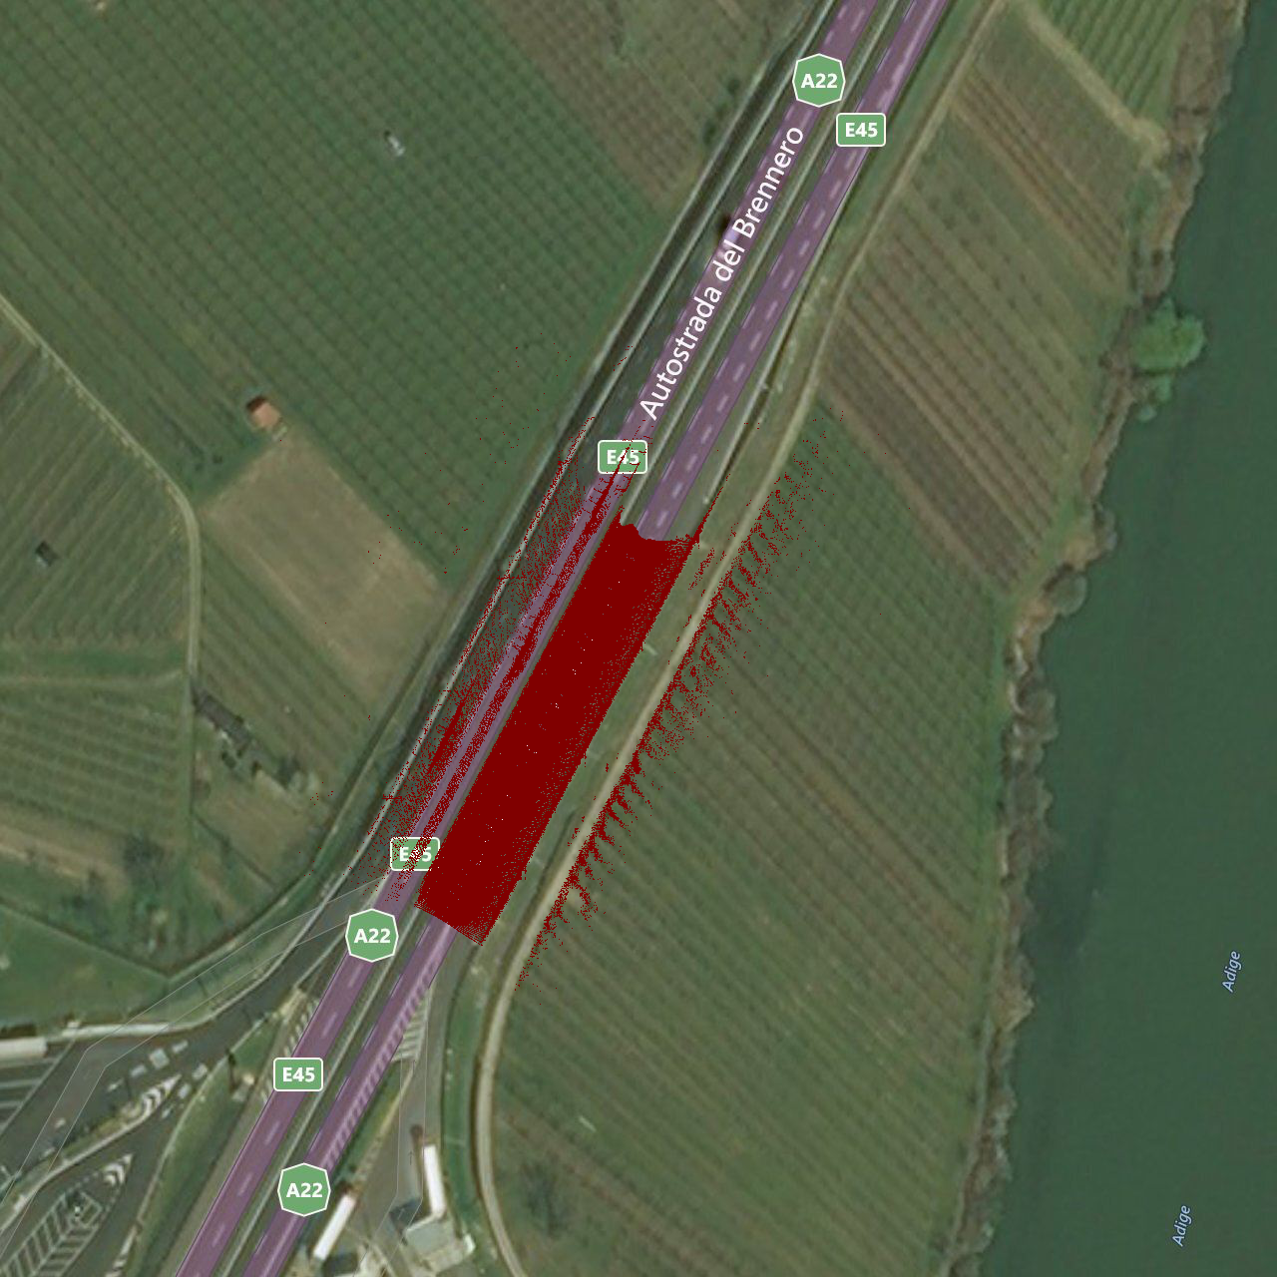
Experiment
Smoothing

Slide 13
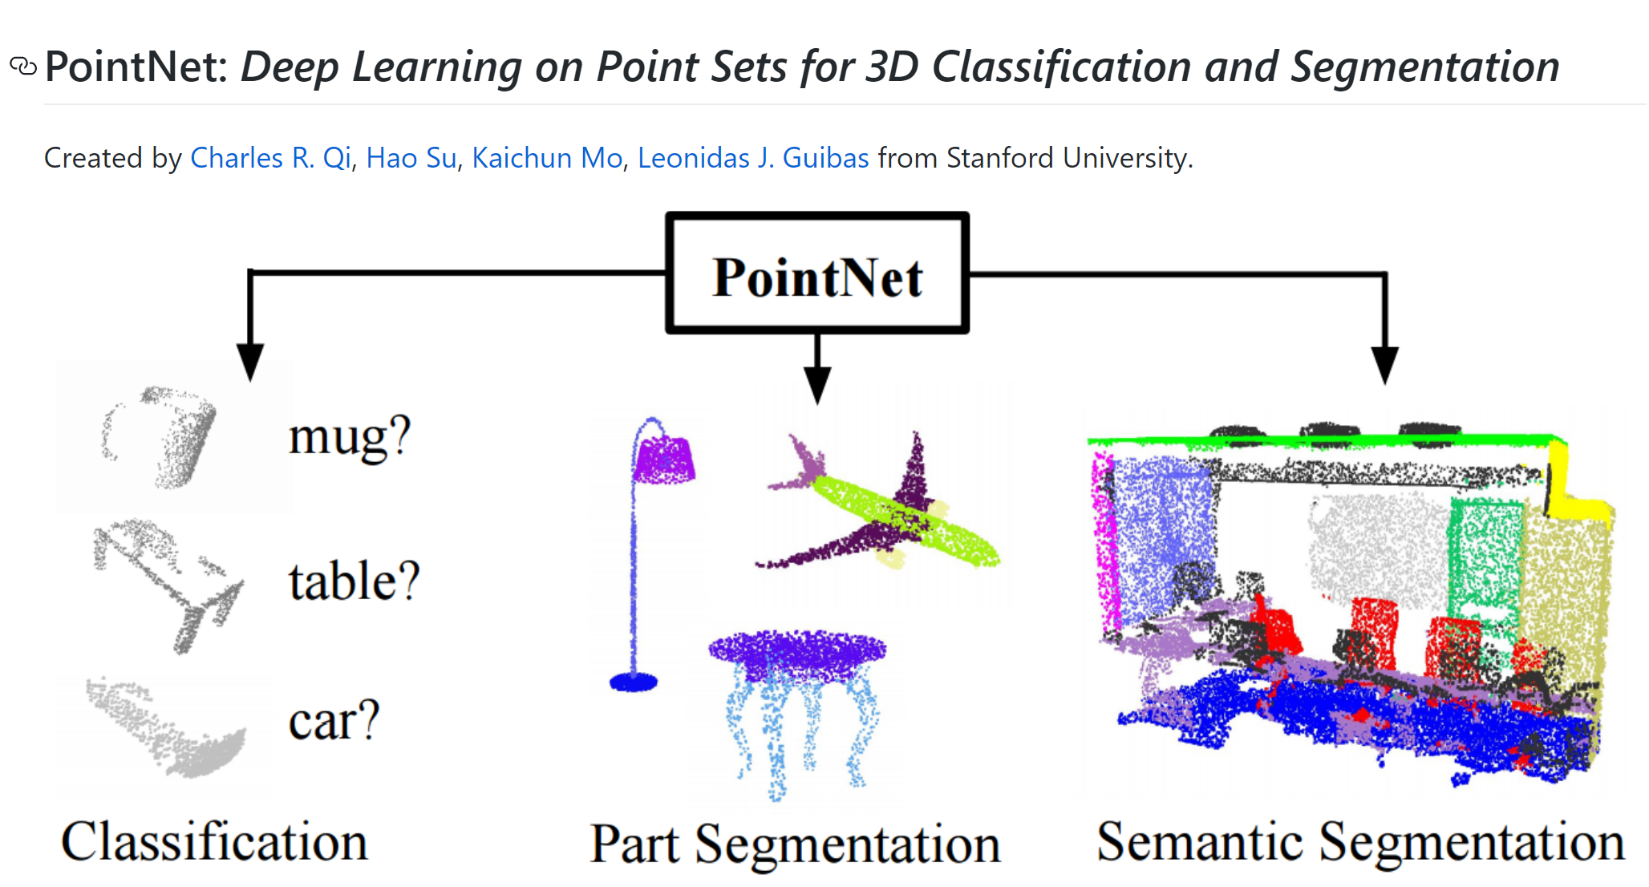
Future experiments

Slide 14
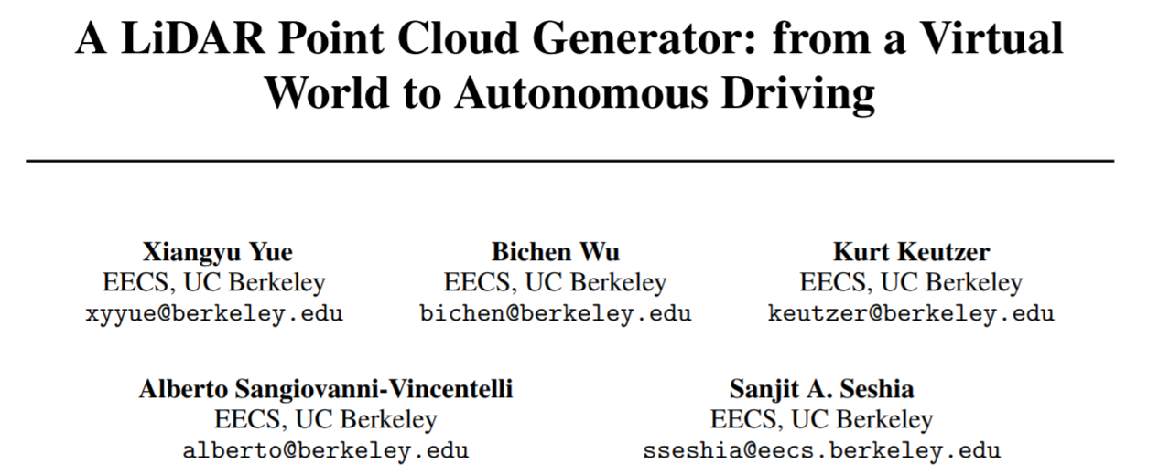
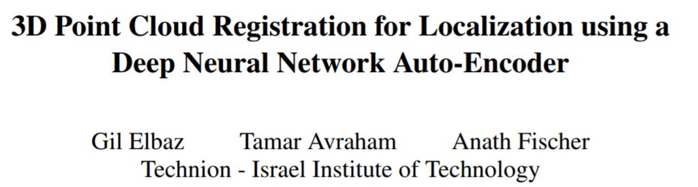
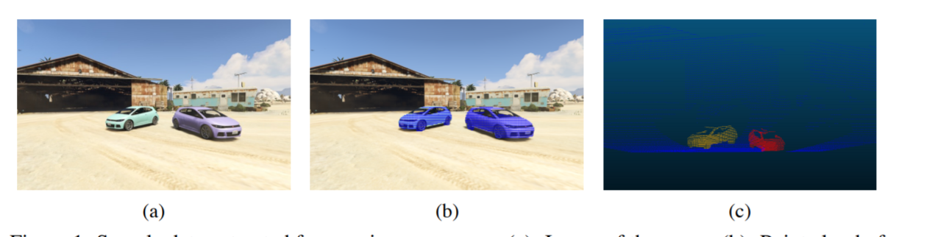
Future Experiments

Slide 15
Questions?
Thank you

